Slide 1
Graphs of CO2 as function of time
Chengyu Chen

Slide 2
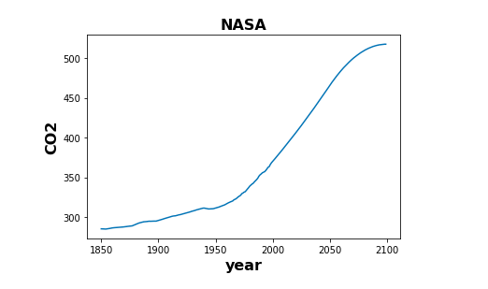
Data from NASA

Slide 3
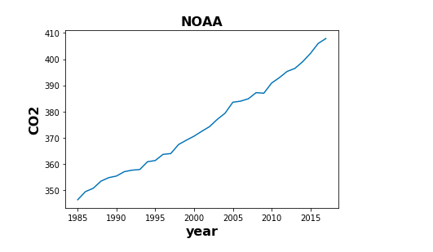
Data from NOAA

Slide 4
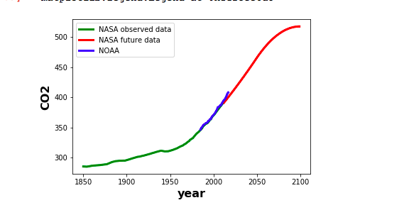
Graph containing both NASA and NOAA data

Slide 5
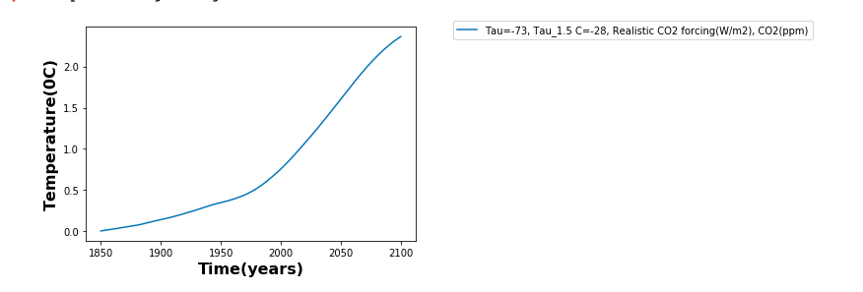
Realistic CO2 forcing Model

Slide 6
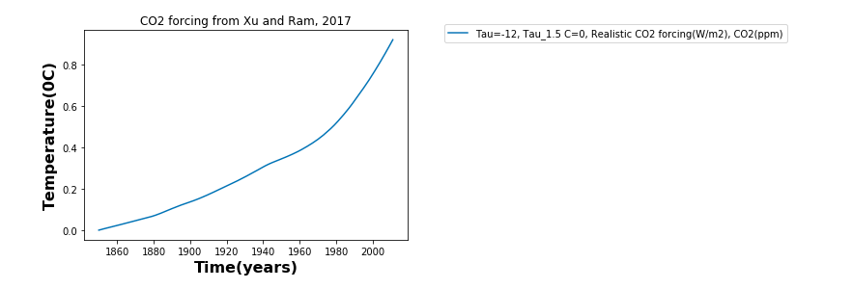
CO2 forcing from Xu and Ram, 2017

